Slide 1
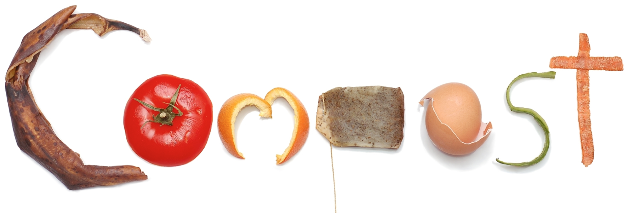
And why it’s fun
Notes:
Supplementary Material:
Food items
Bag of Compost
Vermicompost Bin

Slide 2
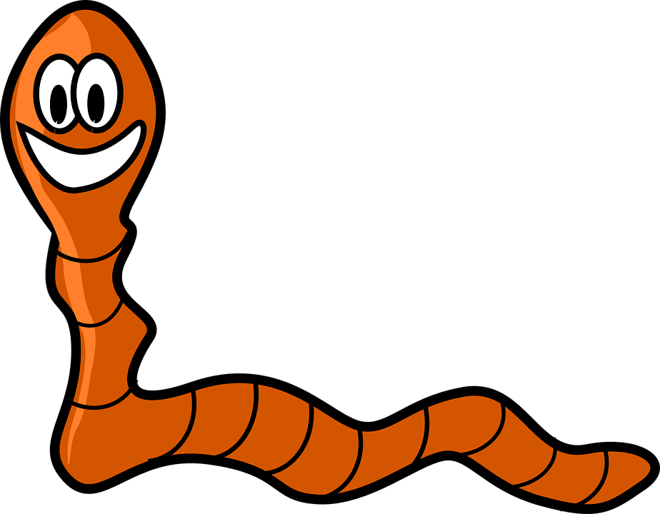
WHAT IS COMPOST?
Yum, I love food scraps!
Notes:
Making compost is fun and easy!
It’s made by recycling food scraps and other things like paper.

Slide 3
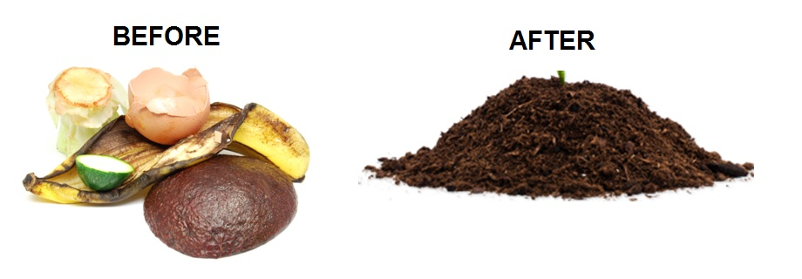
Transform Your food!
That looks tasty!
Notes:
Composting turns your leftover Lunch into food for plants
We add compost to soil , it adds nutrients that help plants grow

Slide 4
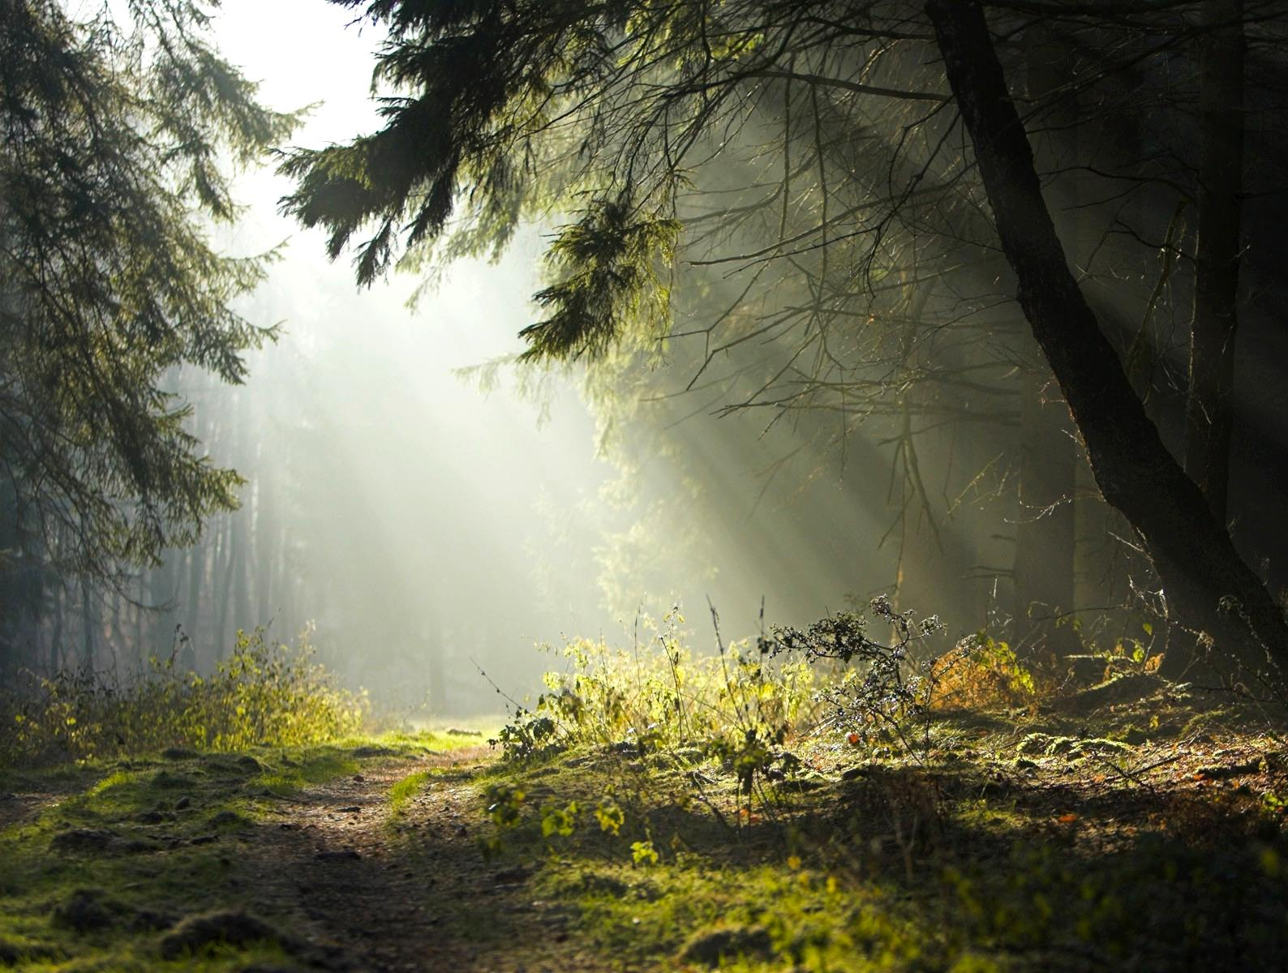
The Forest Floor
Notes:
In the forest, nature recycles leaves and plants
After plants die, they turn into soil
Plants are biodegradable
Composting does the same thing with our leftover food

Slide 5
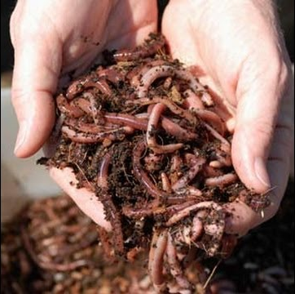
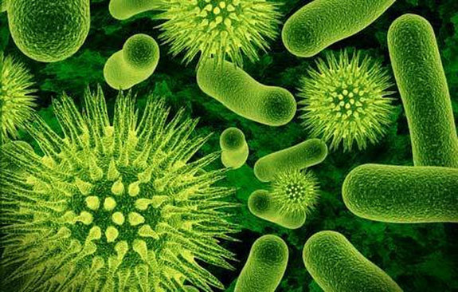
Bacteria and Other Critters
Notes:
Compost is created by hungry bacteria, fungi, worms, insects, and other creatures.
They eat things that are biodegradable
These critters do most of the work for us, we just have to feed them
They don’t mind eating rotten things

Slide 6
What is Biodegradable?
Guessing Game!
Notes:
Biodegrable: is something that is able to break down with the help of bacteria, fungi and other creatures.
Things that are biodegradable can be composted!

Slide 7
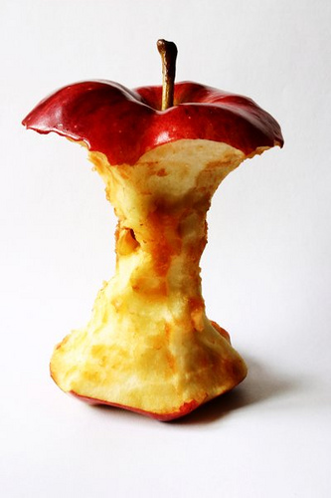
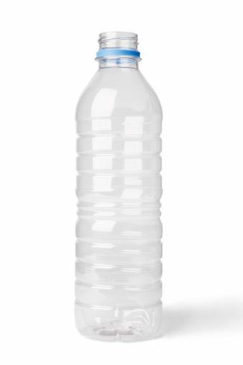
Apple Core? Water Bottle?
Notes:
Apple Core? Yes
Water Bottle? No

Slide 8
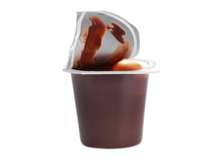
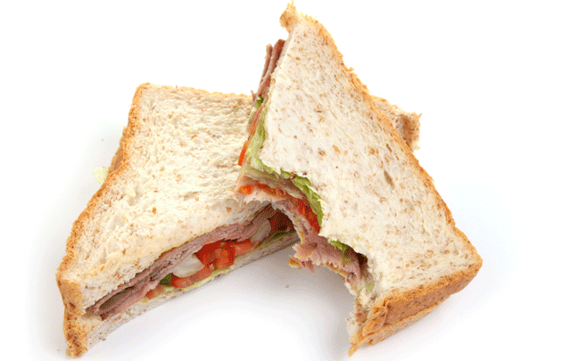
Pudding Cup?
Sandwich?
Notes:
Pudding Cup? No
Sandwich? Yes

Slide 9
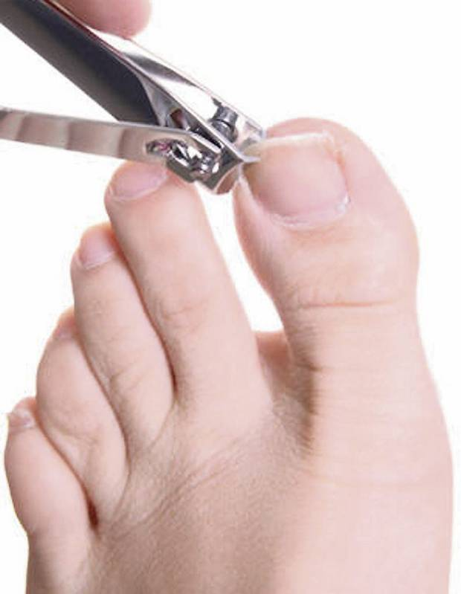
Straws?
Toe Nails?
Notes:
Straws? No
Toe nails? Yes

Slide 10
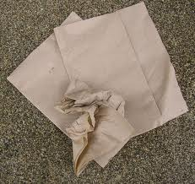
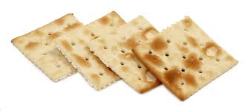
Crackers?
Napkins?
Notes:
Napkins? Yes
Crackers? Yes

Slide 11
Why is Composting good?
GO COMPOST!
Notes:
It keeps food out of landfills where it goes to waste
Compost helps plants and gardens grow
It helps prevent climate change: less methane (pollutes air) and leachate (pollutes water) production in landfills

Slide 12
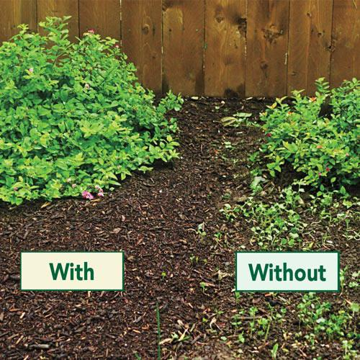
Plant Comparison
Notes:
With or without compost

Slide 13
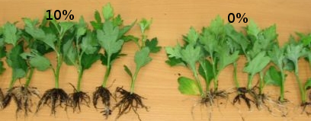
Plant Comparison
Notes:
With or without compost

Slide 14
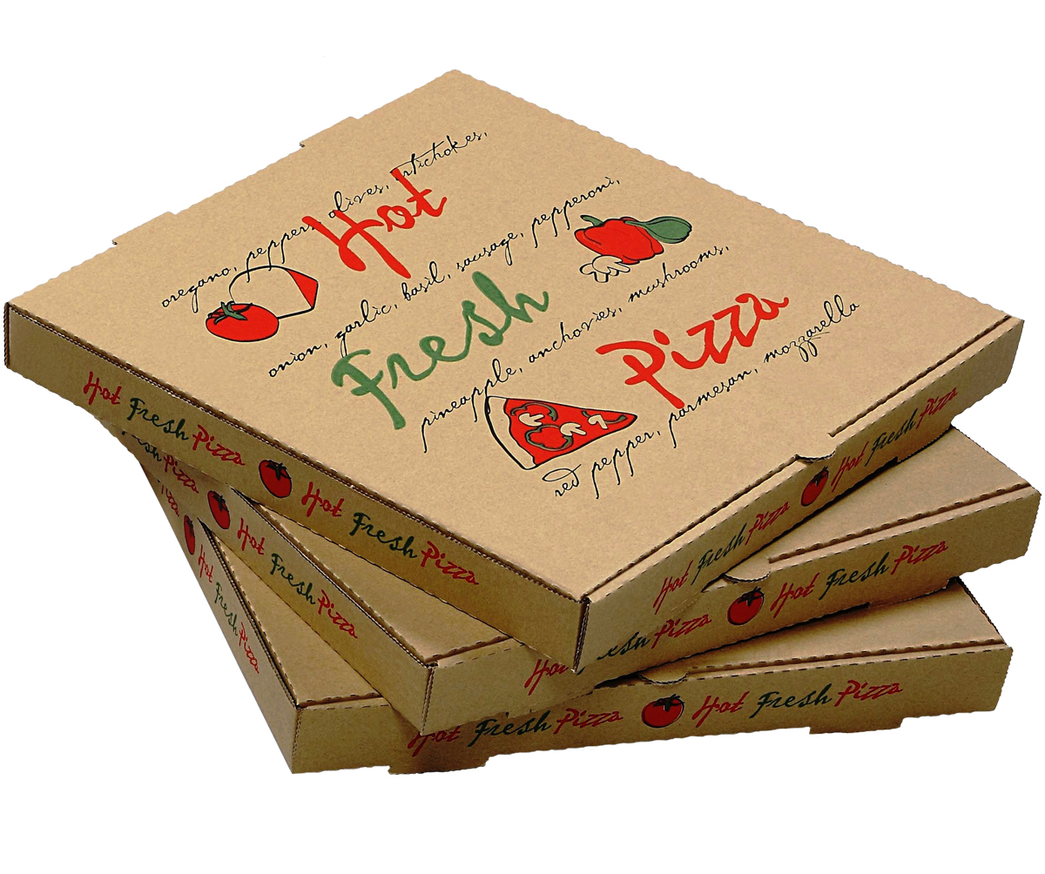
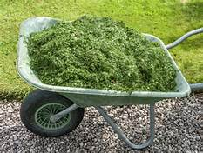
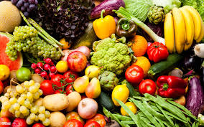
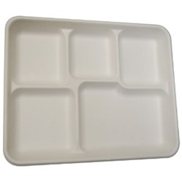
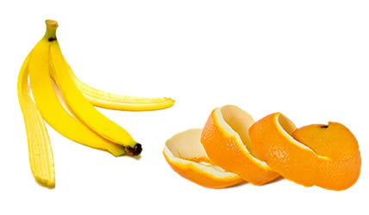
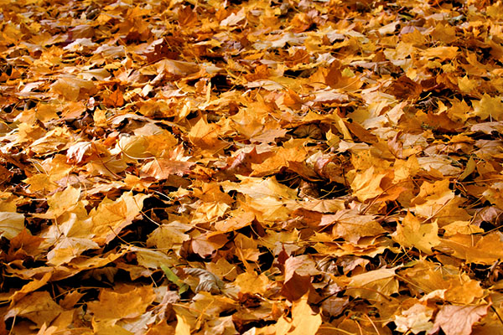
What to Compost
Notes:
preface this in person with "Compost at home dos and don'ts"

Slide 15
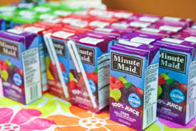
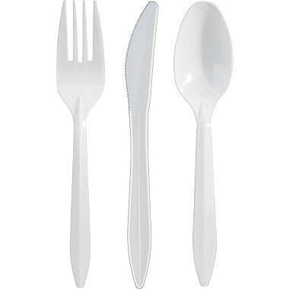
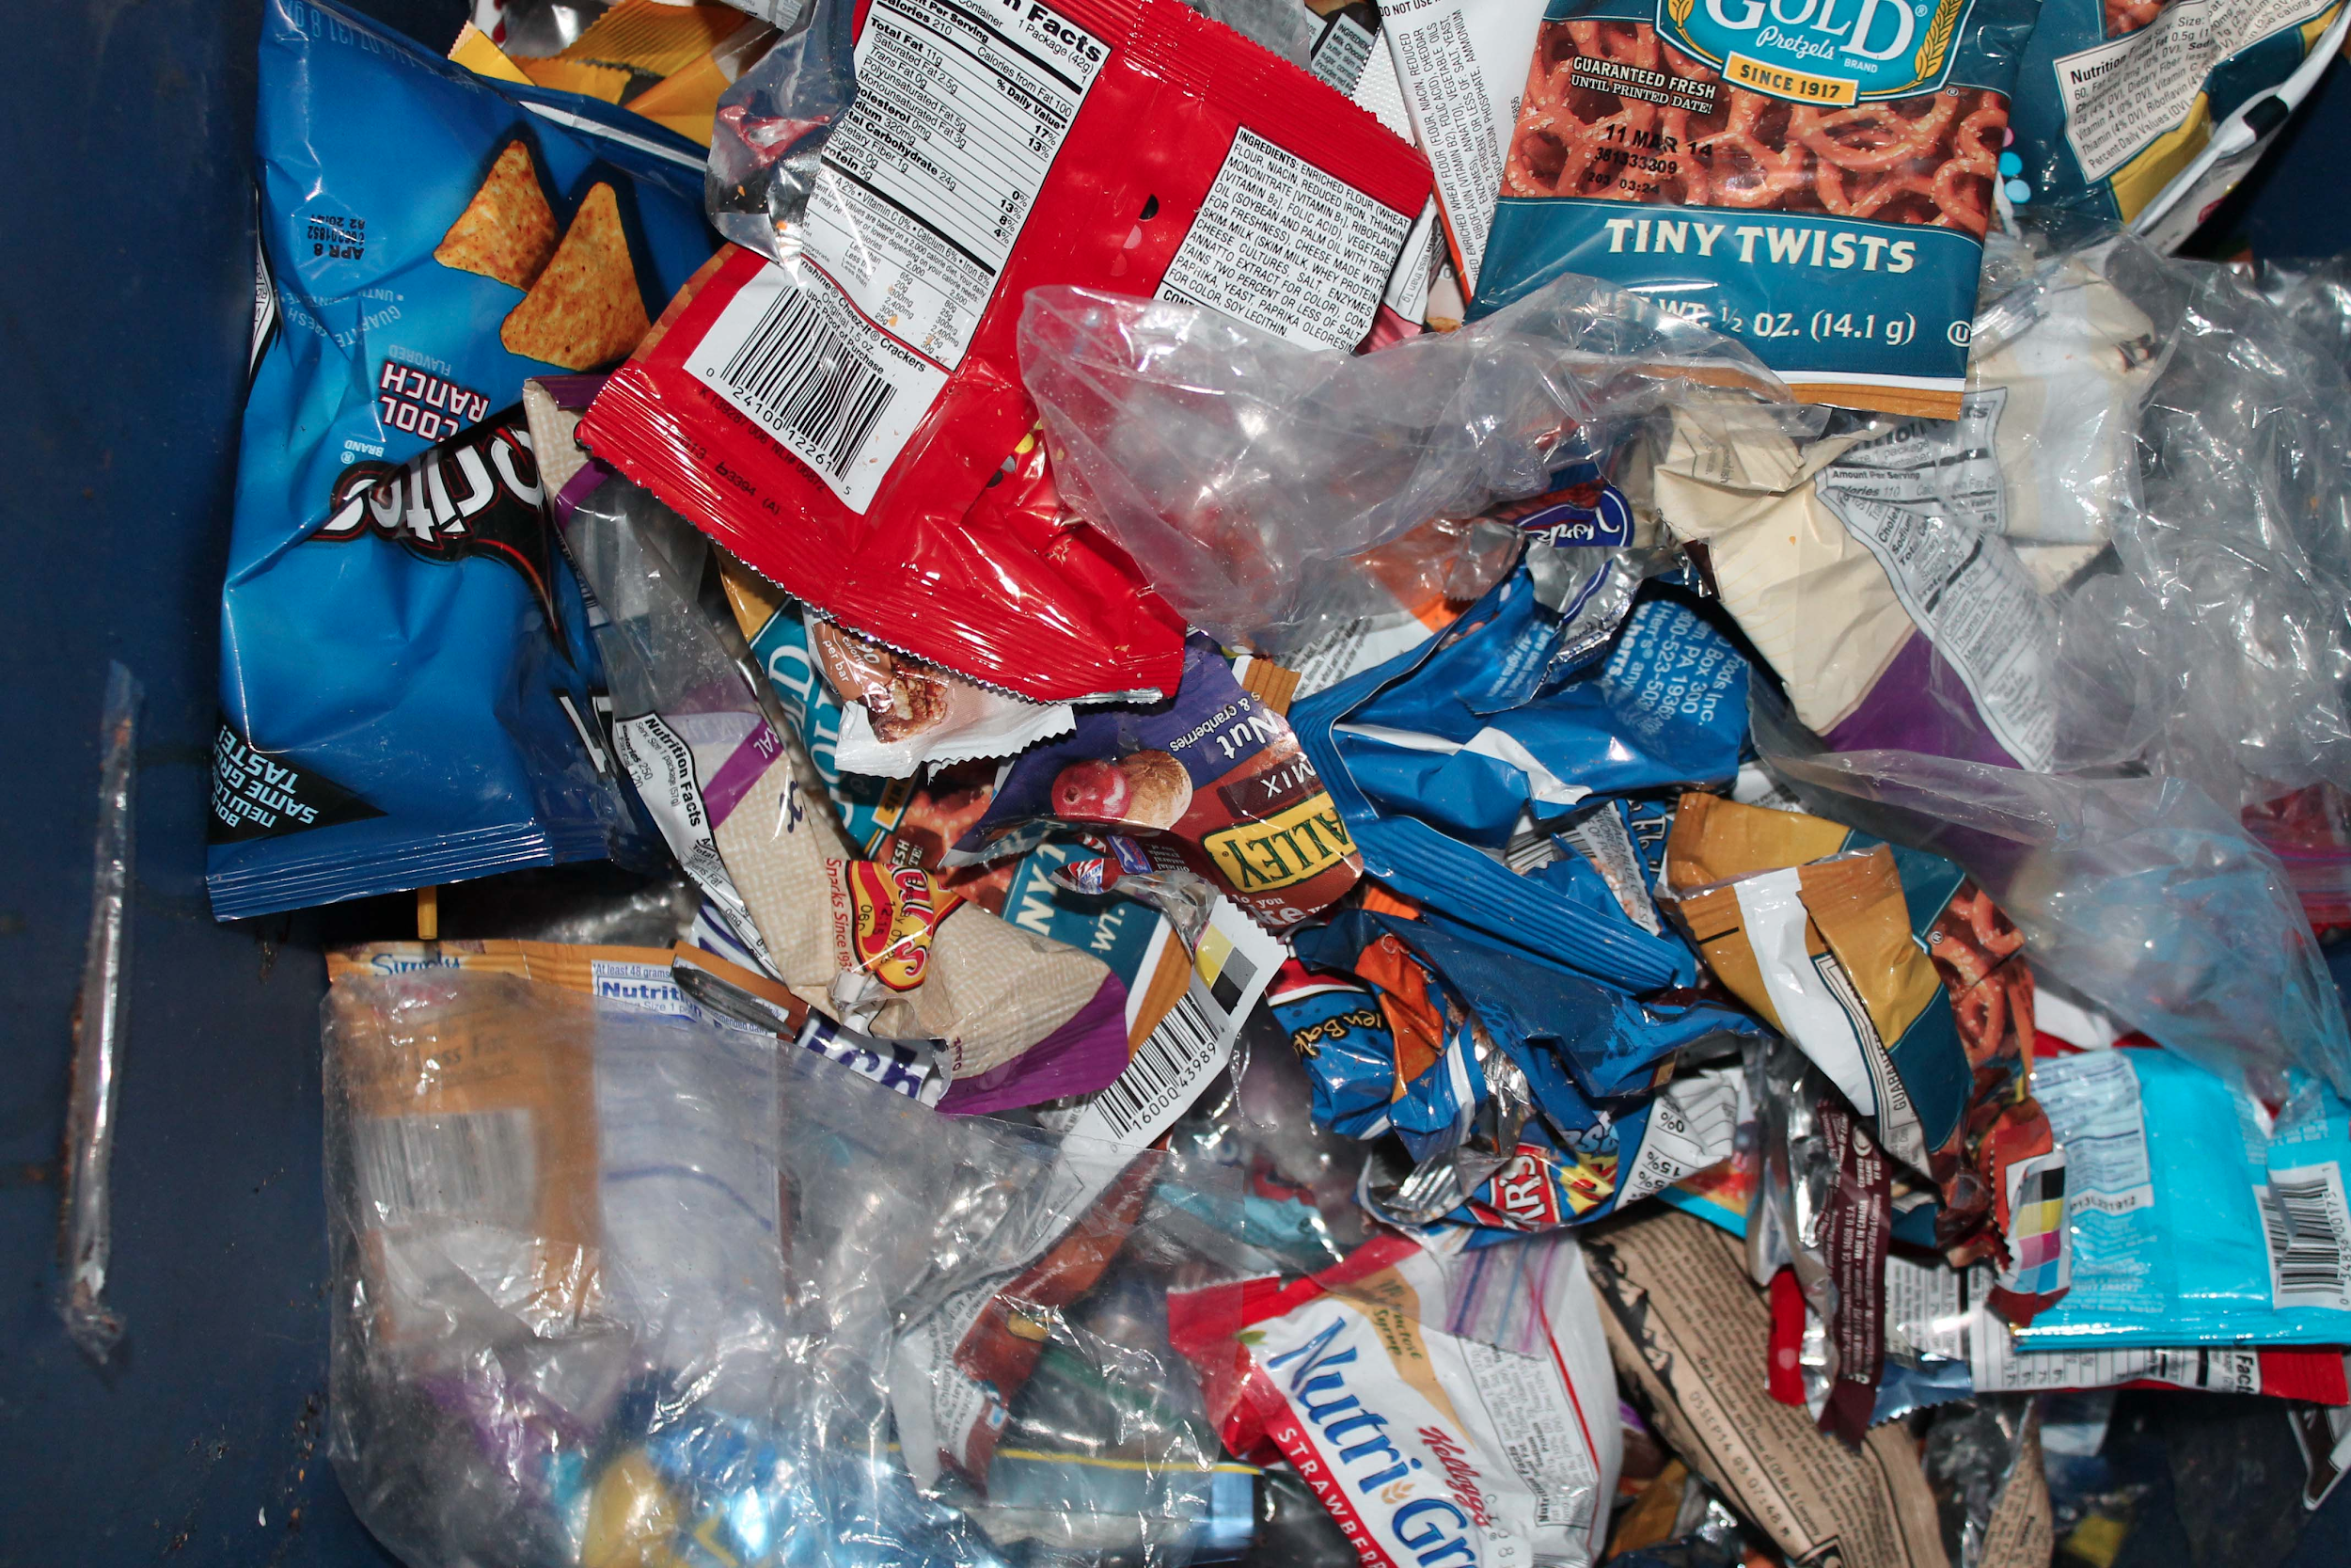
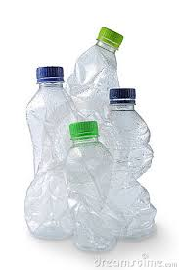
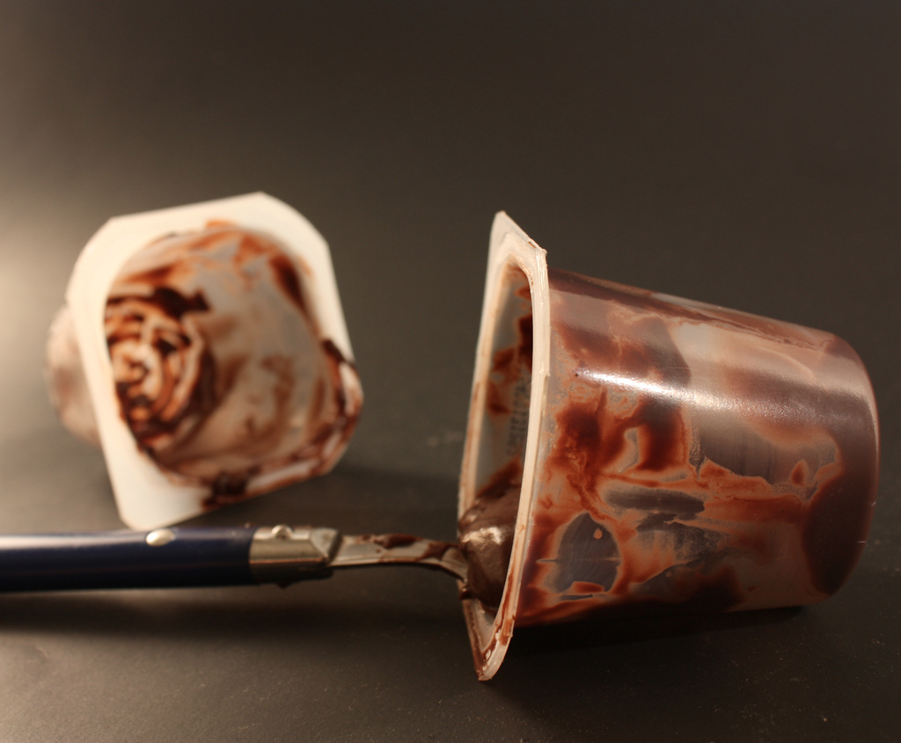
What NOT to Compost
Notes:
preface this in person with "Compost at home dos and don'ts"

Slide 16
3 Ingredients
Needed to Make Compost
Green Things - Have a lot of NITROGEN
Fruits, vegetables, grass clippings, coffee grounds
Brown Things - Have a lot of CARBON
Dry Leaves, paper, sticks
Blue Things - Air and Water

Slide 17
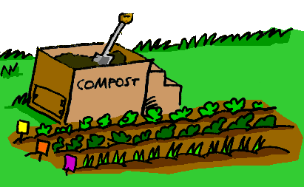
Can you compost at home?
Yes you can!
Talk to your parents about starting a compost bin at home
Start one outside and make compost yourself
Find instructions at the following link: ecocycle.org/backyard-composting

Slide 18
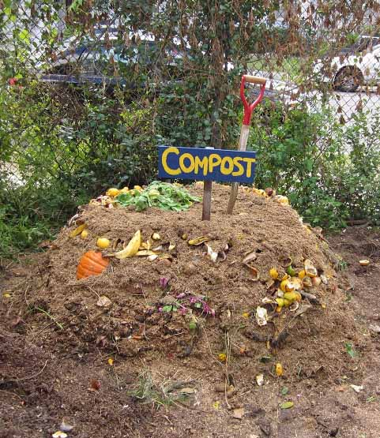
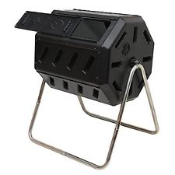
How Do We Compost at Home?
Start by making a compost pile or getting a compost bin
Then start collecting compostable items to add in

Slide 19
Can you compost at school?
Yes you can! Talk to your teacher about:
Putting leftover fruits and vegetables in the compost bin outside. The compost you make can go in a school garden.
Starting a full pilot compost program in the school lunchroom. Then you can compost meat, bones and paper too!
Notes:
Possibly would be different if the school already composts

Slide 20
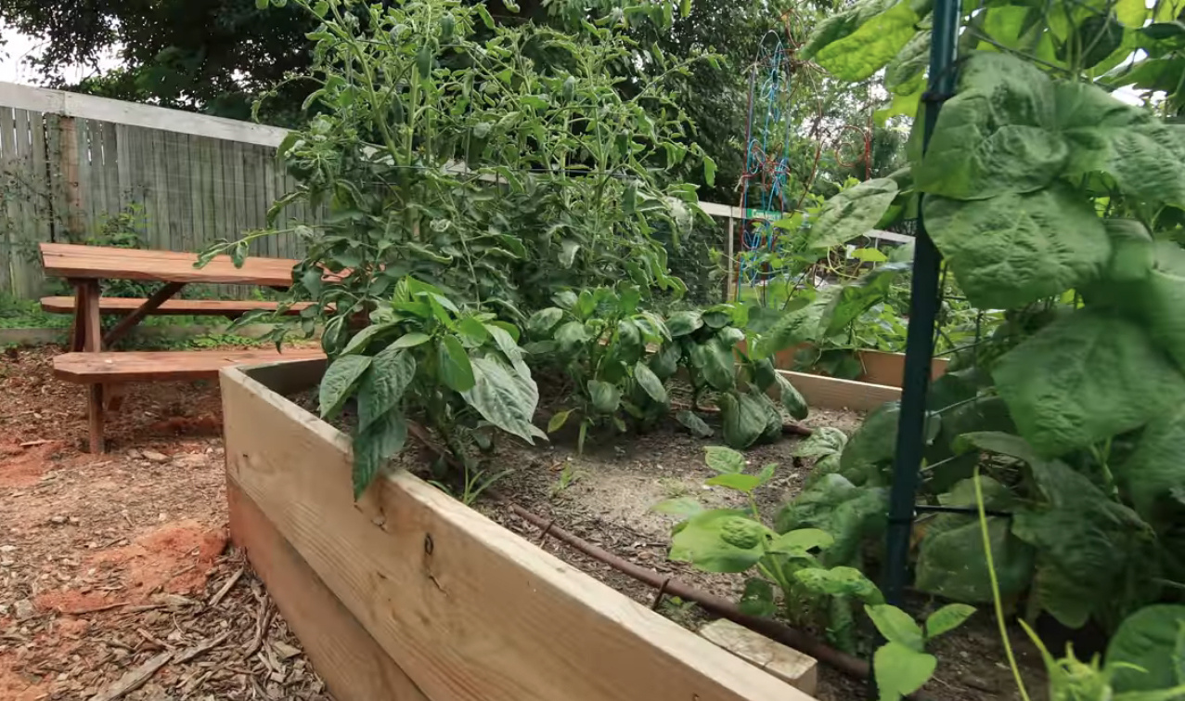
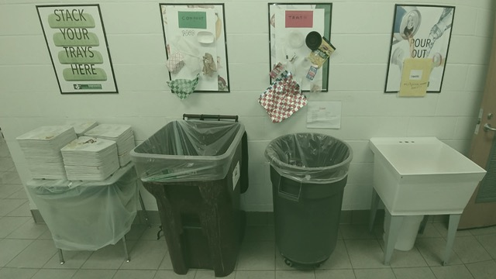
How Can We Compost at School?
Notes:
Start a Green Team
Start a School Garden
In the Lunchroom: talk to your parents, teachers and principal about starting a composting pilot
Visit www.EveryTrayCounts.org for more information

Slide 21
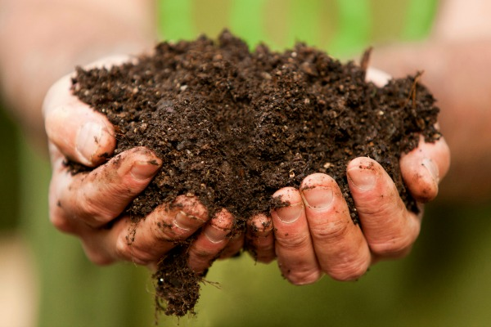
Thank You

Slide 22
www.everytraycount.org everytraycounts@gmail.com

