Slide 1
Lunchroom Quiz
Trash or Compost?

Slide 2
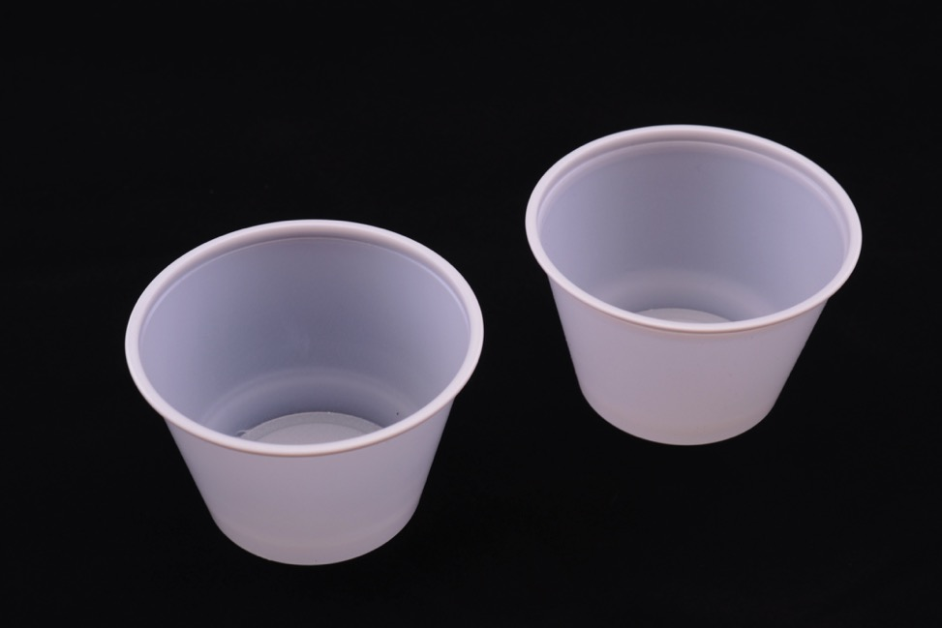
Plastic Cups
Trash or Compost?

Slide 3
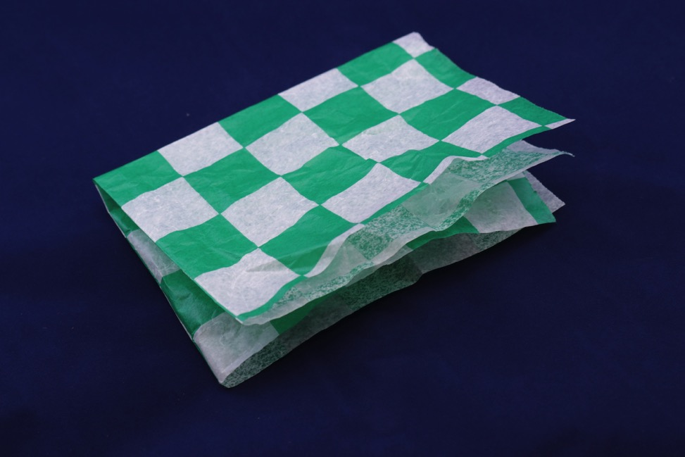
Wax Paper Wrapper
Trash or Compost?

Slide 4
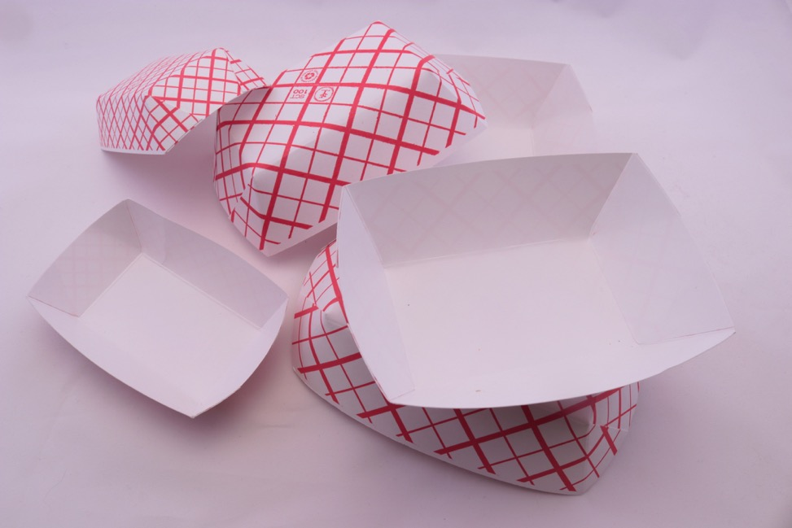
Paper Boats
Trash or Compost?

Slide 5
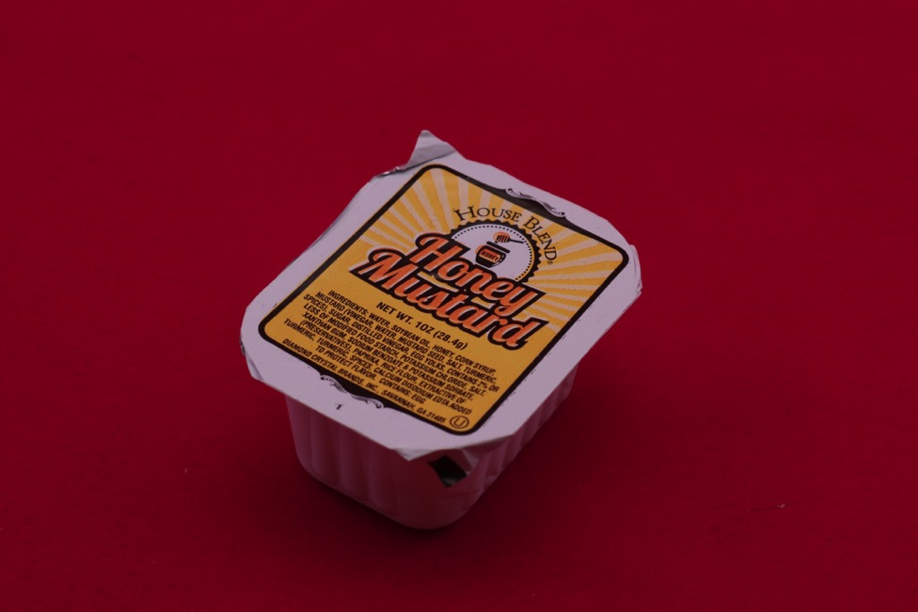
Mustard Pack
Trash or Compost?

Slide 6
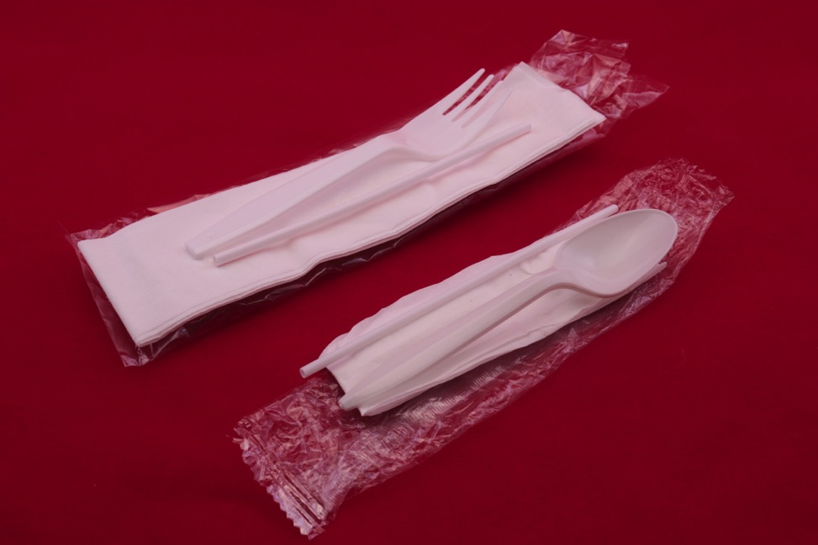
Utensils + Wrapper + Napkin
Trash or Compost?

Slide 7
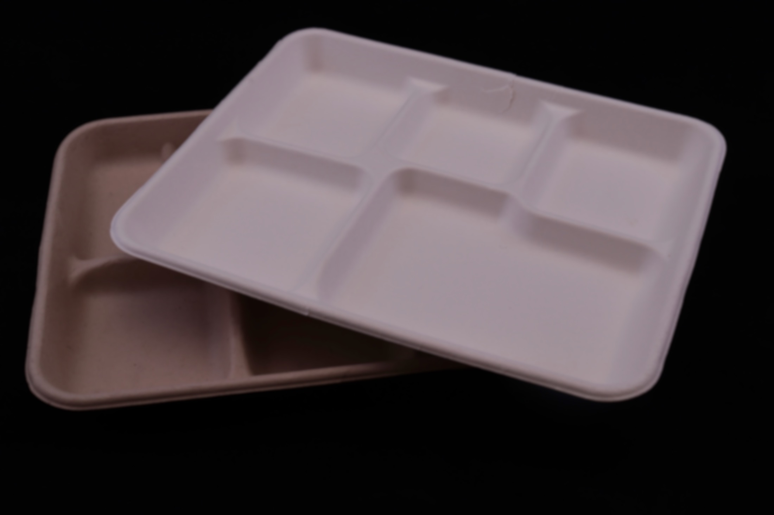
Paper Trays
Trash or Compost?

Slide 8
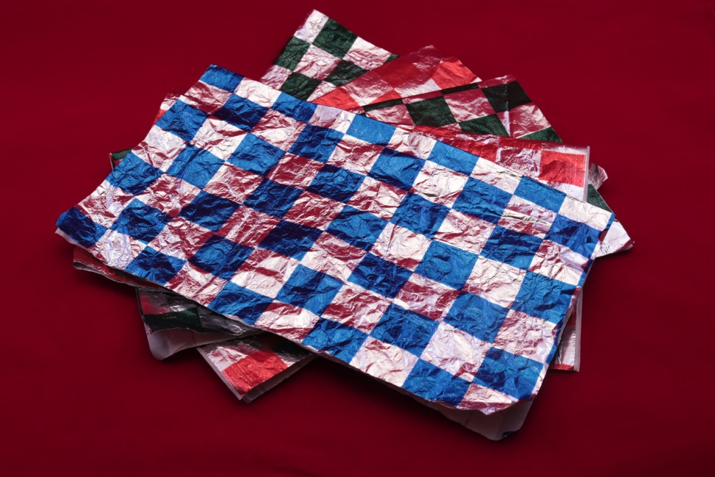
Foil
Trash or Compost?

Slide 9
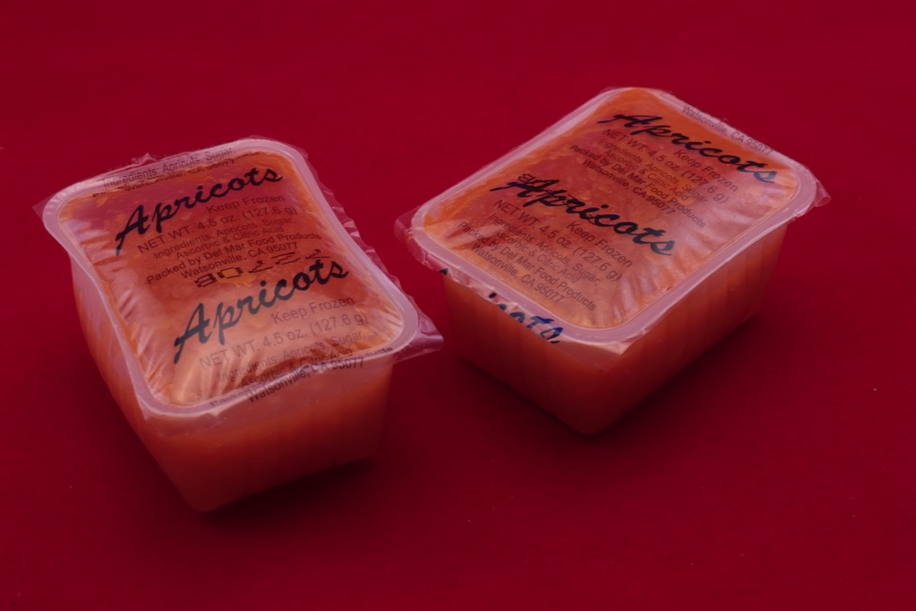
Plastic Fruit Pack
Trash or Compost?

Slide 10
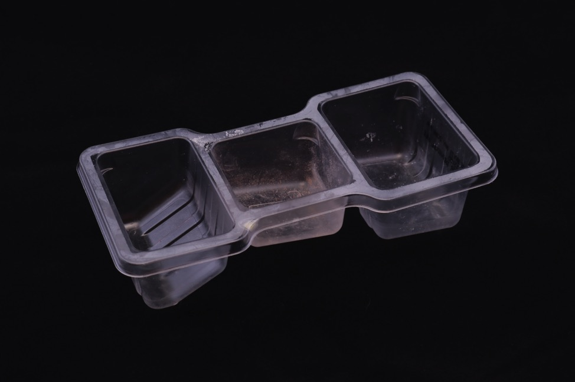
Plastic Snack Pack
Trash or Compost?
Notes:
Plastic Snack Container

Slide 11
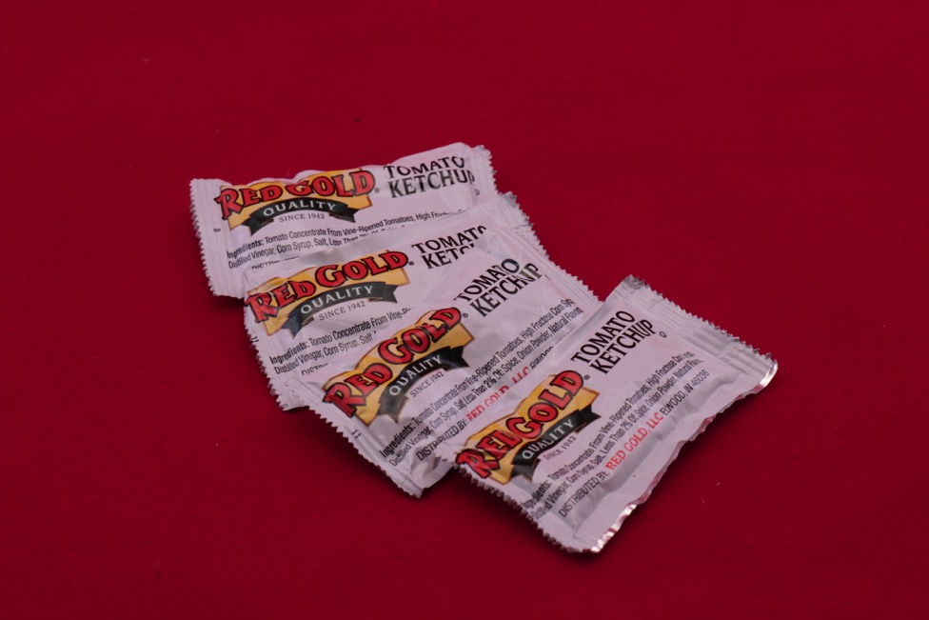
Ketchup Packets
Trash or Compost?

Slide 12
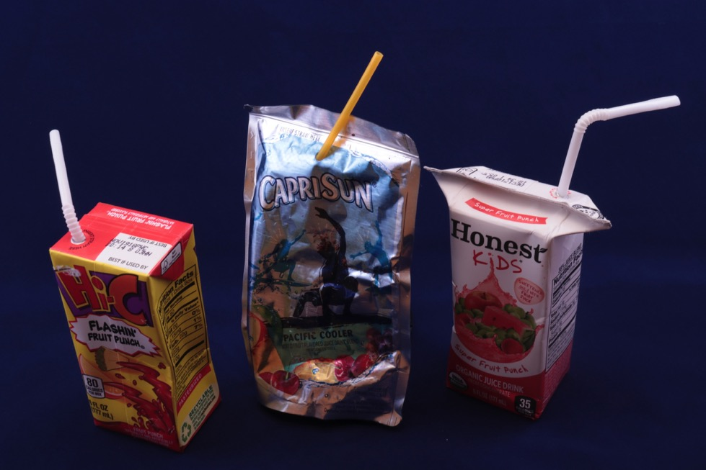
Juice Pouch + Boxes
Trash or Compost?

Slide 13
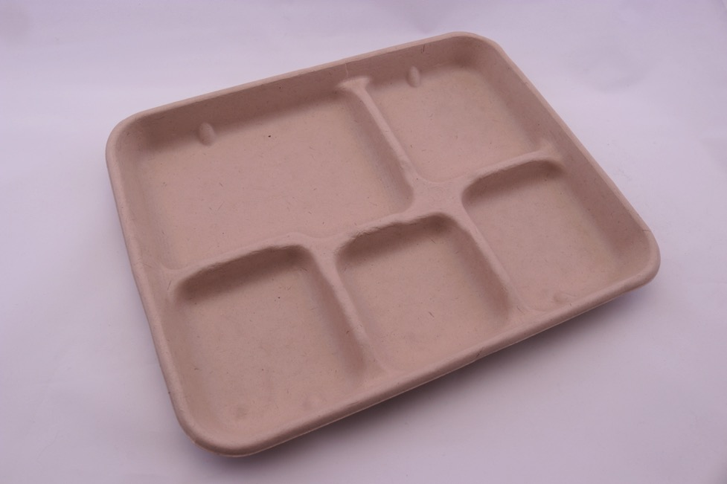
Paper Tray
Trash or Compost?
Notes:
Paper Tray

Slide 14
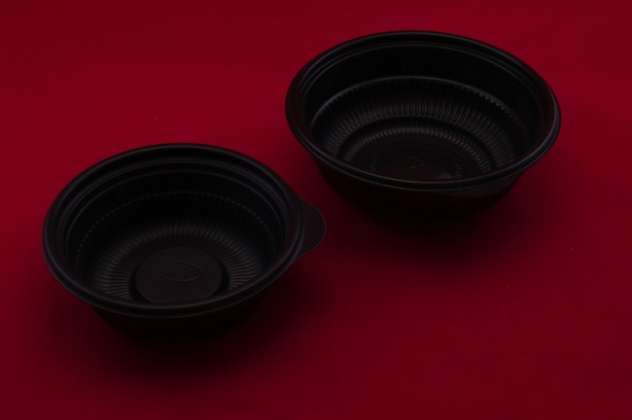
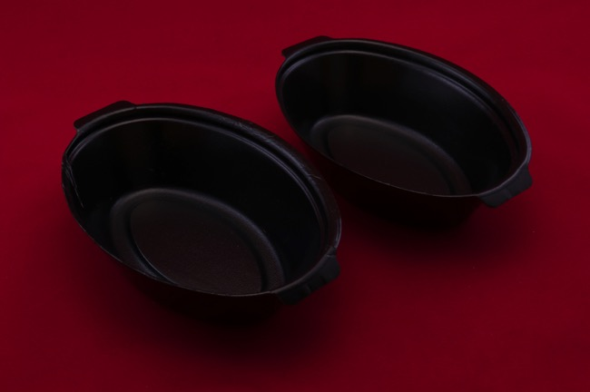
Plastic Bowls
Trash or Compost?

Slide 15
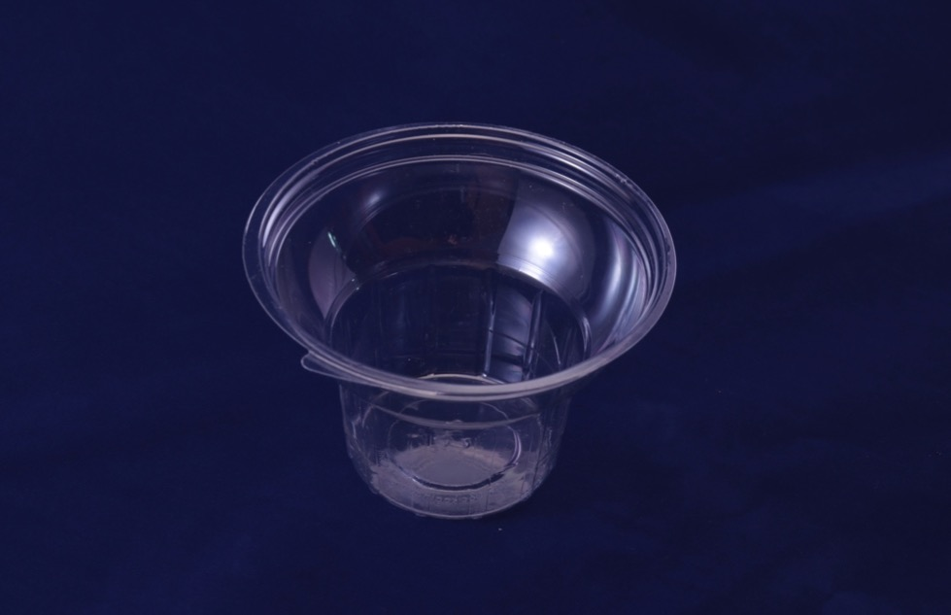
Plastic Ice Cream Cup
Trash or Compost?

Slide 16
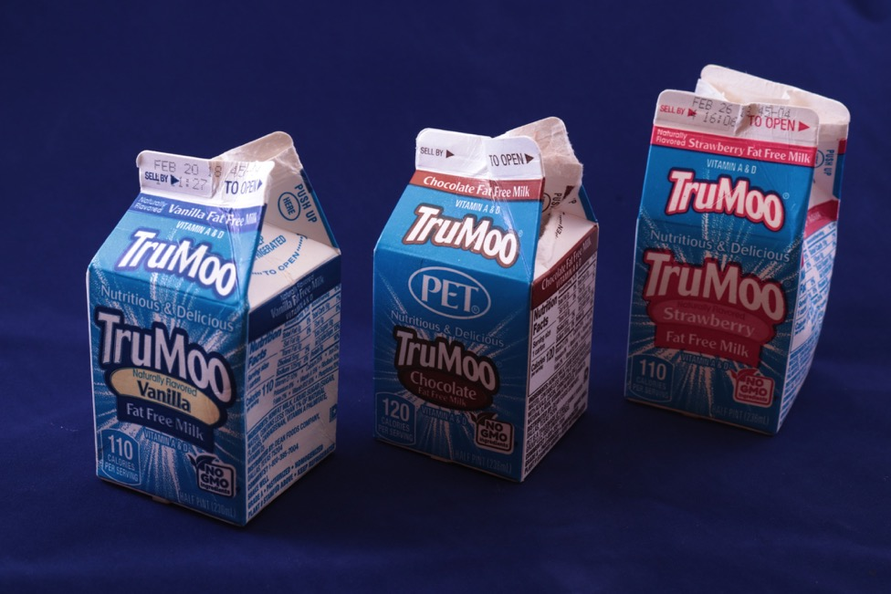
Milk Cartons
Trash or Compost?

Slide 17
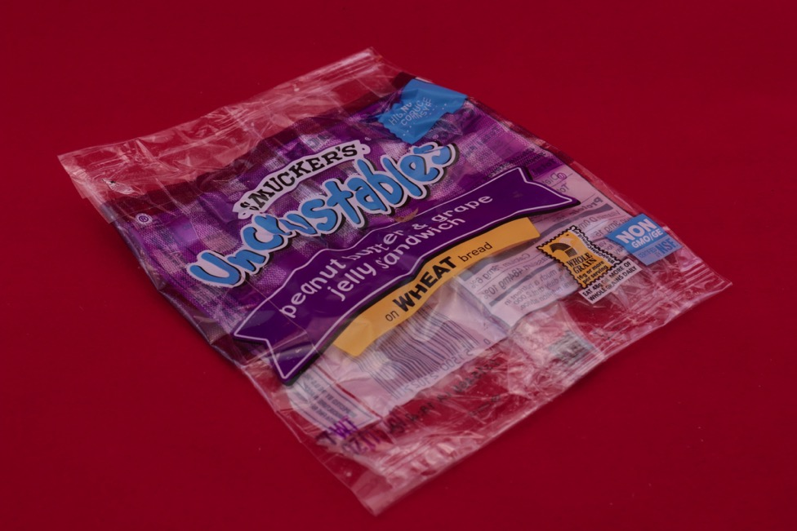
PB+J Sandwich Wrapper
Trash or Compost?

Slide 18
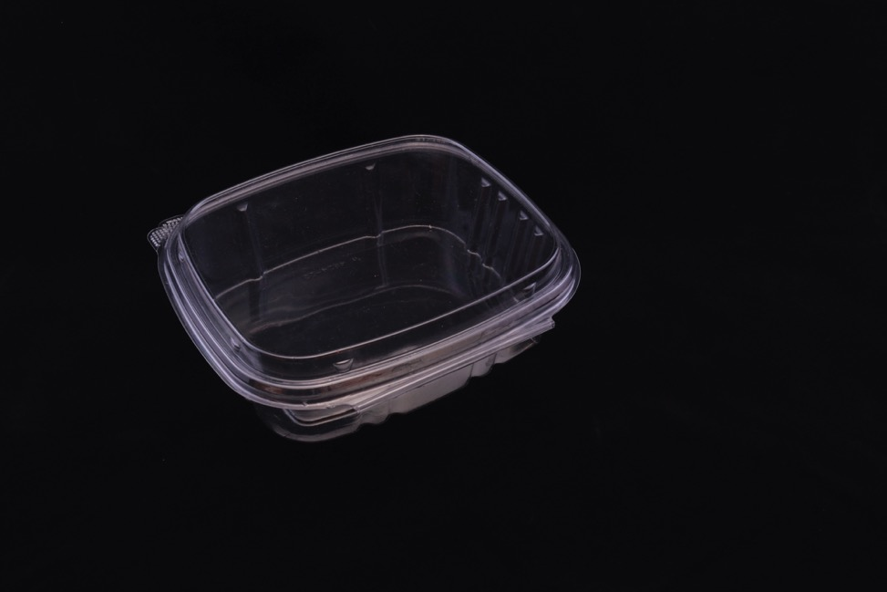
Plastic Clam Shell
Trash or Compost?

Slide 19
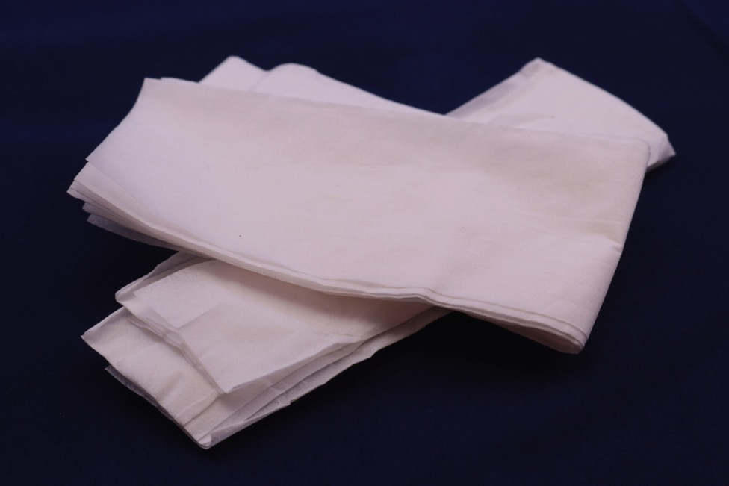
Paper Napkins
Trash or Compost?

Slide 20
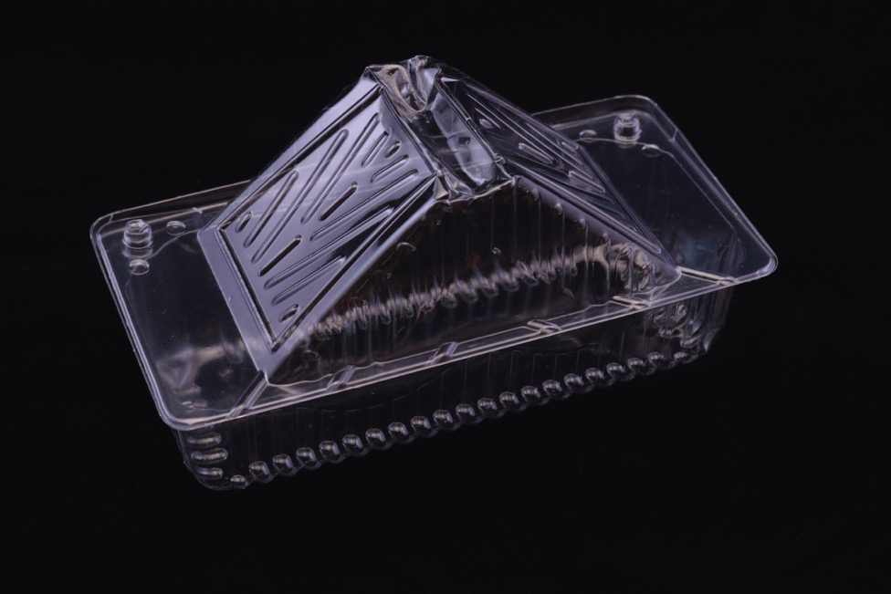
Plastic Sandwich Container
Trash or Compost?

Slide 21
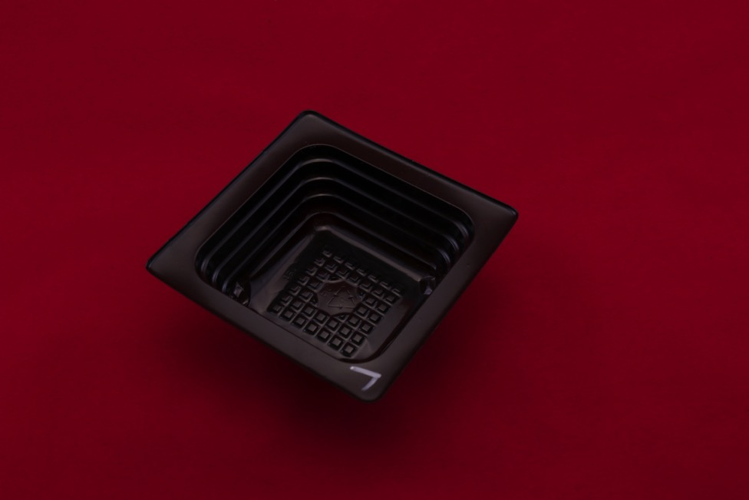
Plastic Container
Trash or Compost?

Slide 22
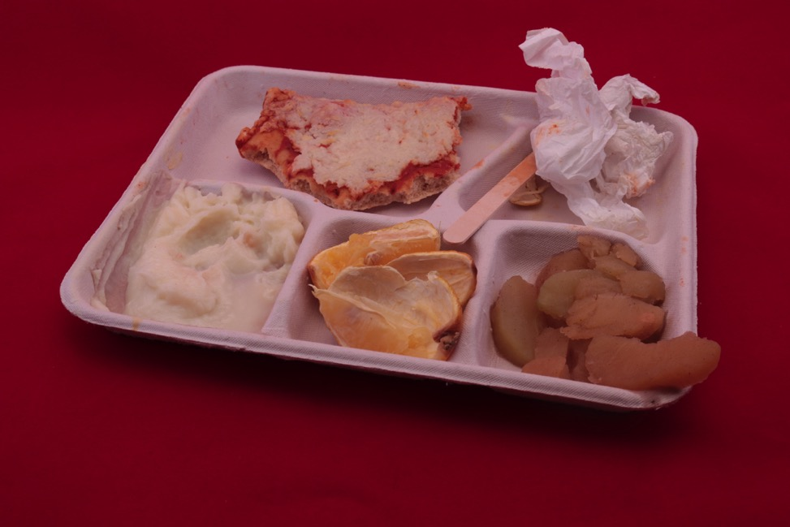
Paper Tray, Paper Napkin, Popsicle Stick + Food Waste
Trash or Compost?

Slide 23
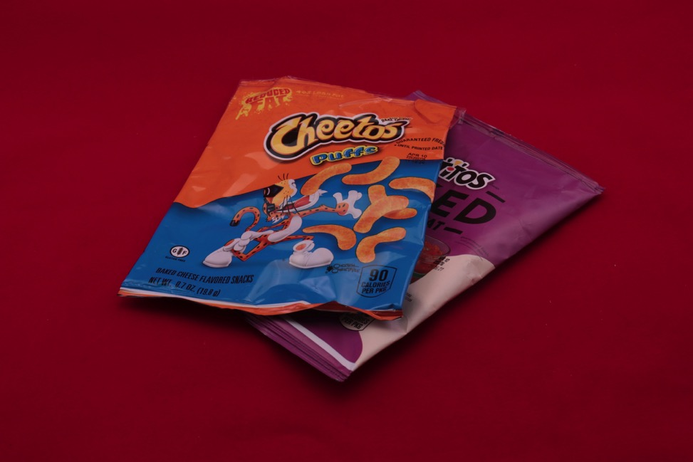
Chips Bags
Trash or Compost?

Slide 24
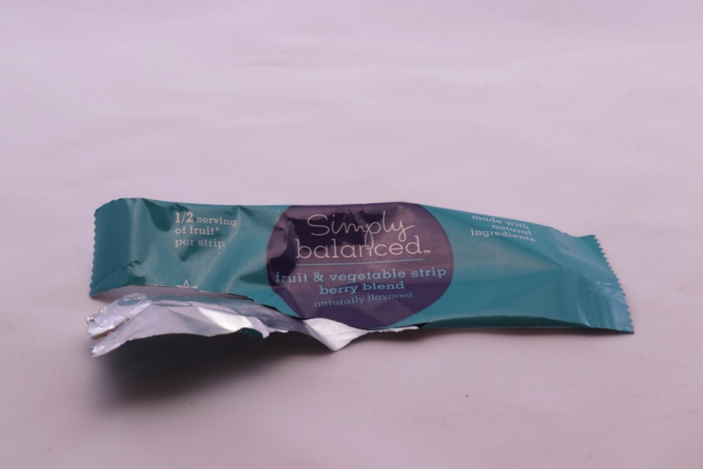
Foil Wrapper
Trash or Compost?

Slide 25
Plastic Cookie Bag
Trash or Compost?

Slide 26
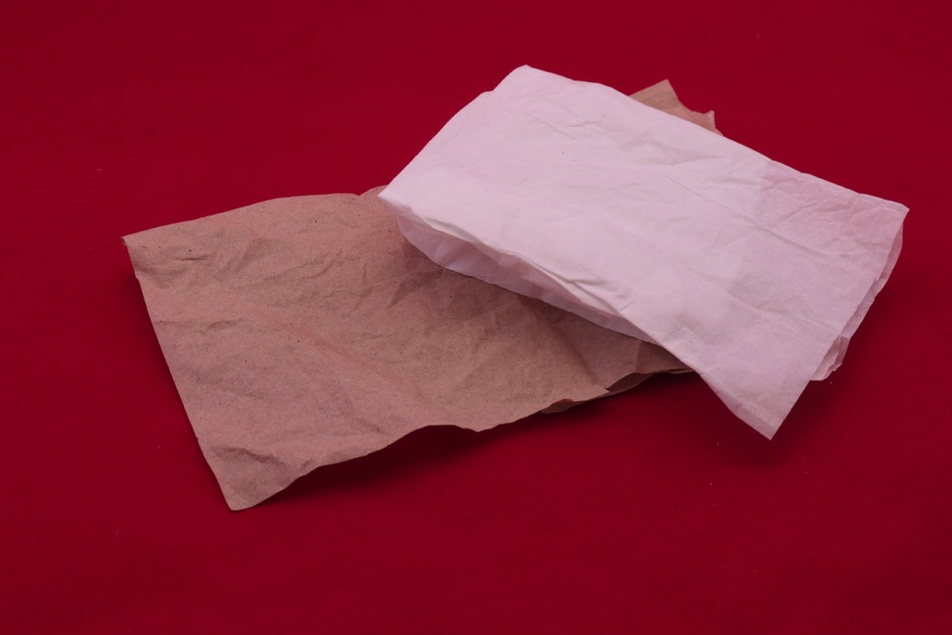
Paper Towels
Trash or Compost?

Slide 27
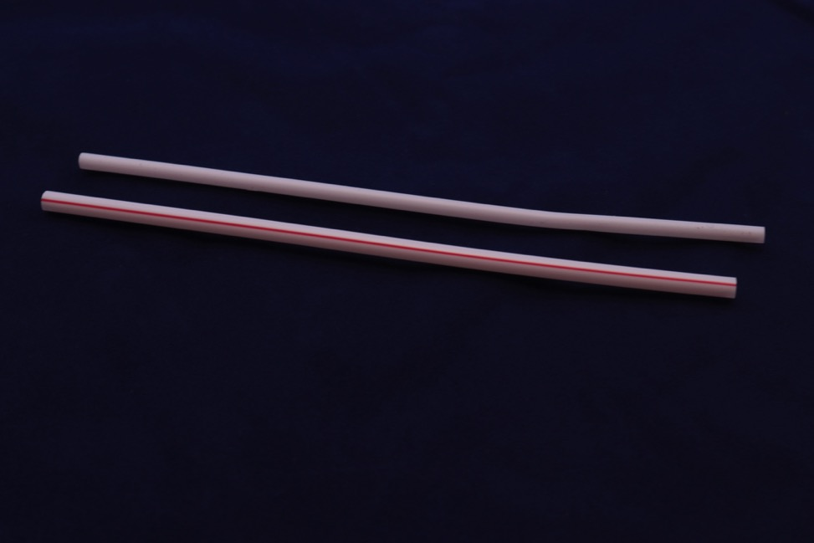
Plastic Straws
Trash or Compost?

