Slide 1
Lunchroom Items

Slide 2
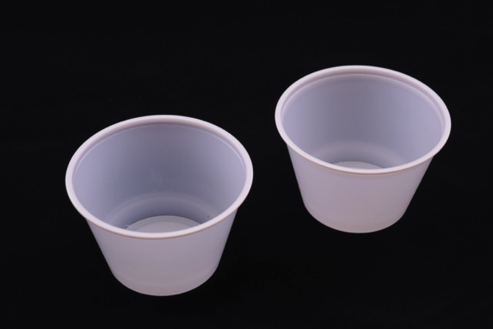
Trash
Notes:
Plastic Cups

Slide 3
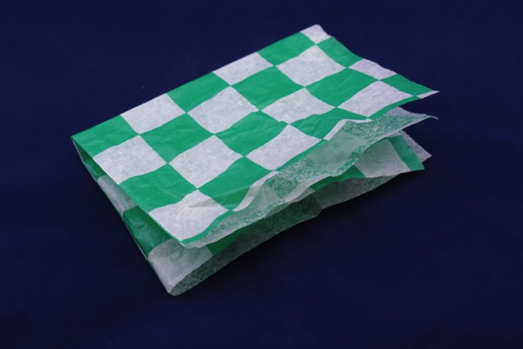
Compost
Notes:
Wax Paper Wrapper

Slide 4
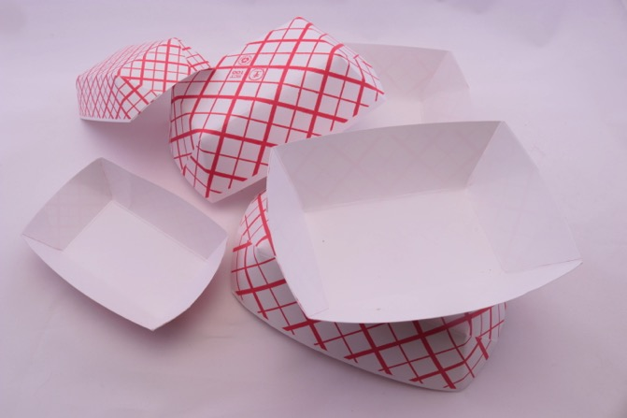
Compost
Notes:
Paper Boats

Slide 5
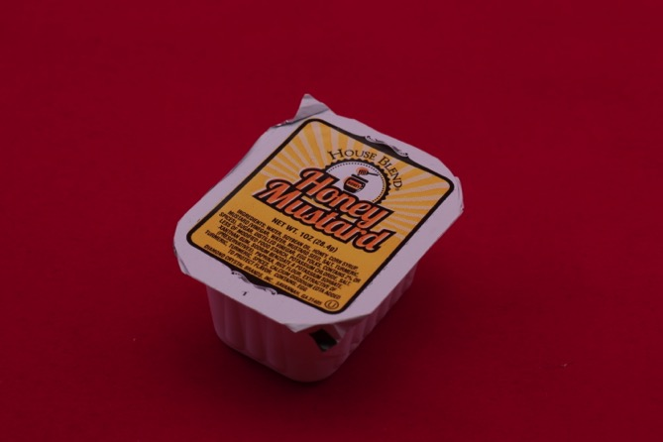
Trash
Notes:
Mustard Container

Slide 6
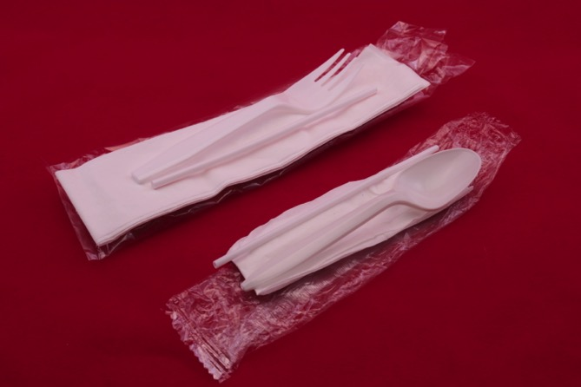
Trash
Notes:
Utensils, napkin and bag

Slide 7
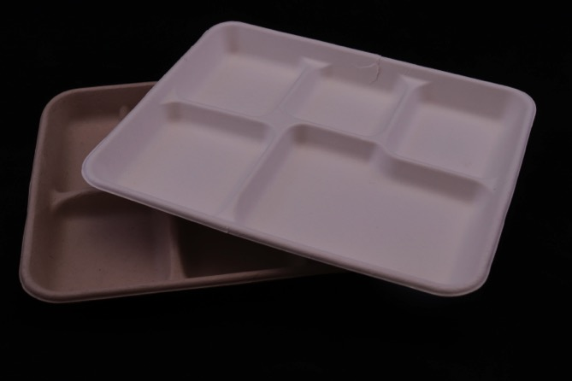
Compost
Notes:
Paper Trays

Slide 8
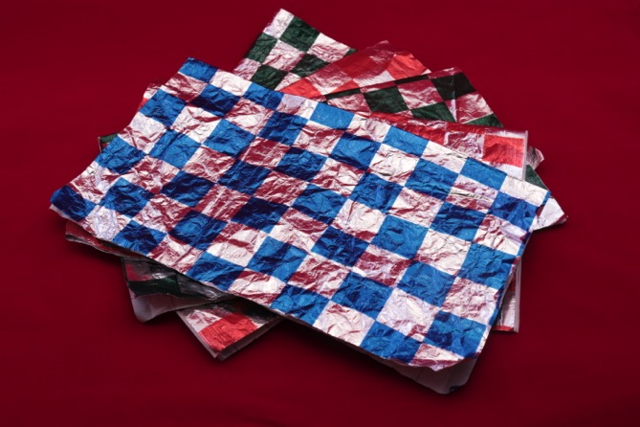
Trash
Notes:
Foil Wrapper

Slide 9
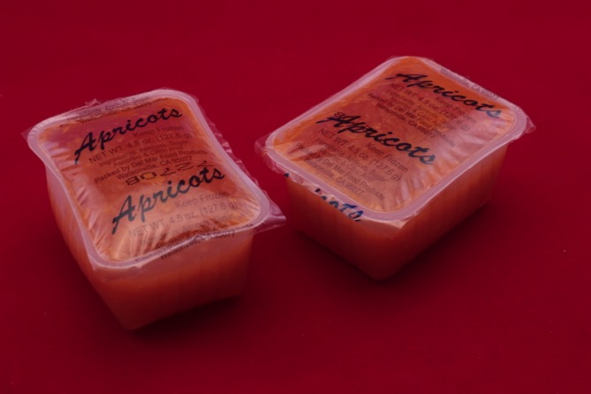
Trash
Notes:
Fruit Pack

Slide 10
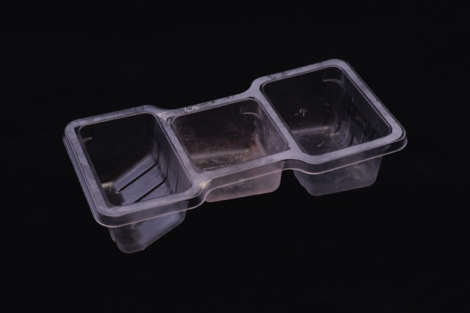
Trash
Notes:
Plastic Snack Container

Slide 11
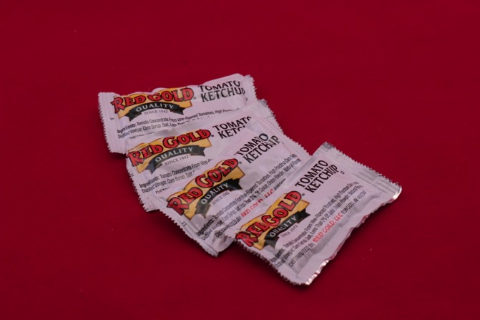
Trash
Notes:
Ketchup Packets

Slide 12
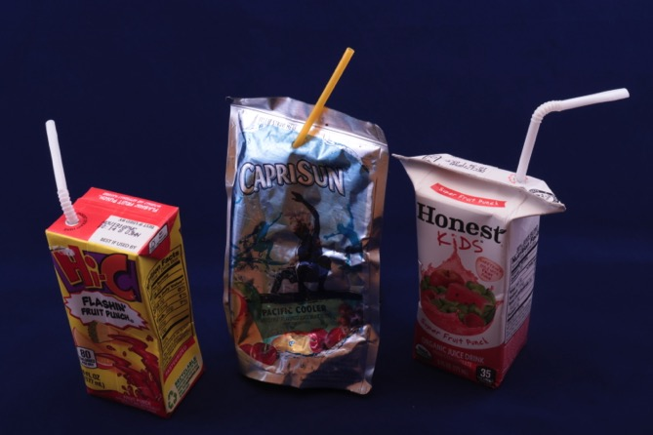
Trash
Notes:
Juice Boxes and Juice Pouch with Straws

Slide 13
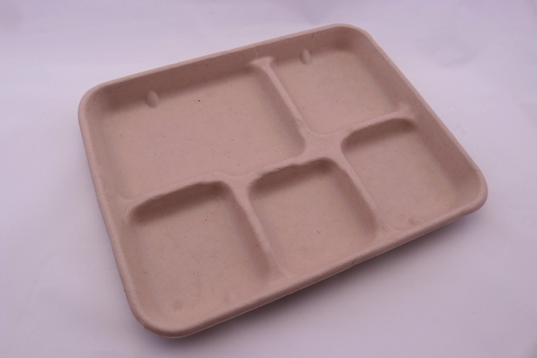
Compost
Notes:
Paper Tray

Slide 14
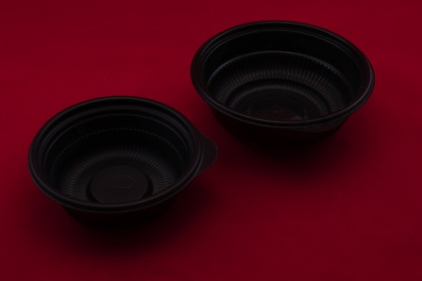
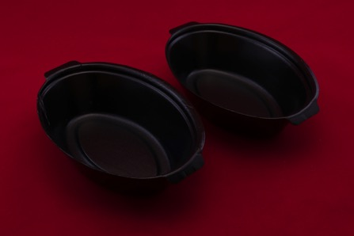
Trash
Notes:
Plastic Bowls

Slide 15
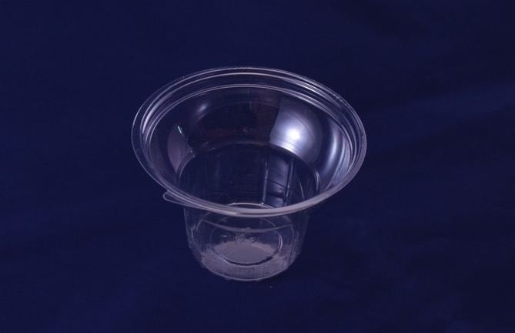
Trash
Notes:
Plastic Ice Cream Cup

Slide 16
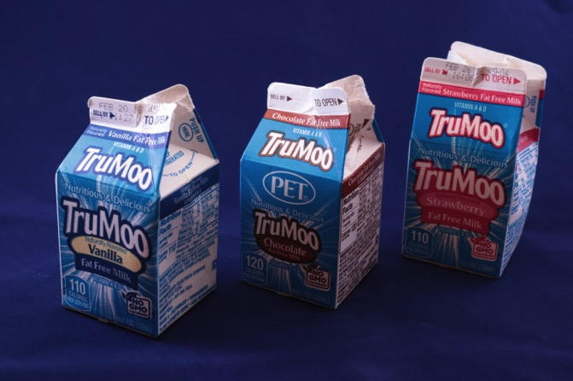
Trash
Notes:
Milk Cartons

Slide 17
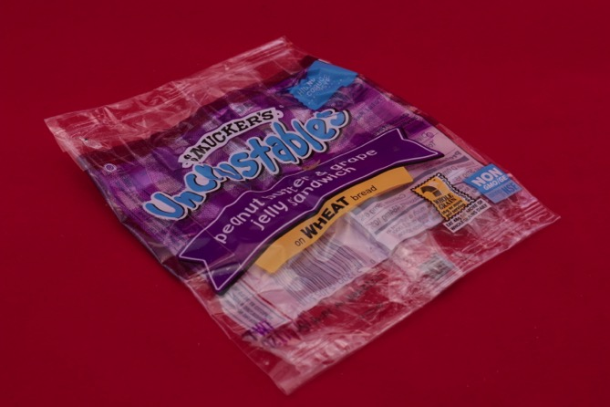
Trash
Notes:
Plastic PB+J Sandwich Wrapper

Slide 18
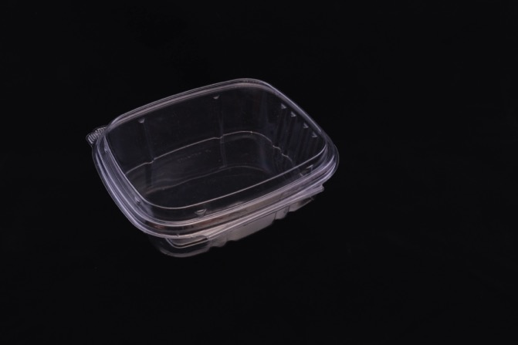
Trash
Notes:
Plastic Clam Shell

Slide 19
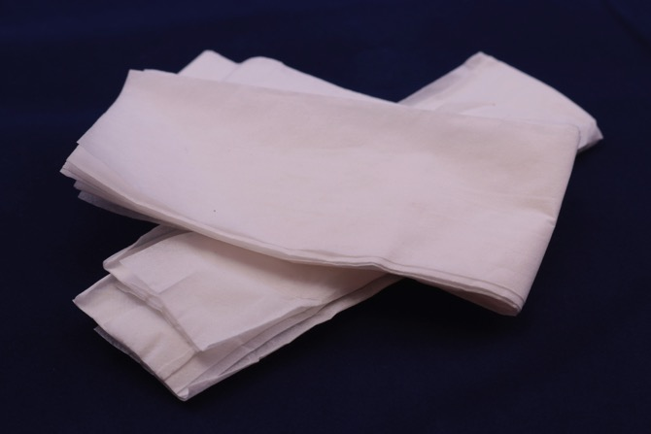
Compost
Notes:
Paper Napkins

Slide 20
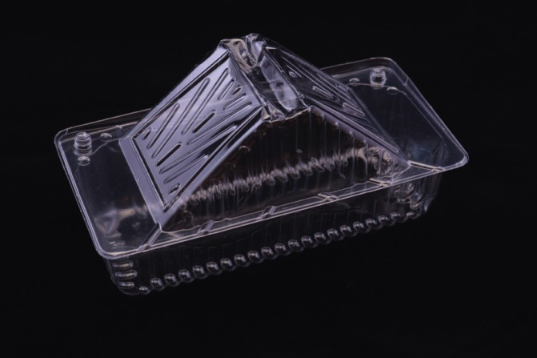
Trash
Notes:
Plastic Sandwich Container

Slide 21
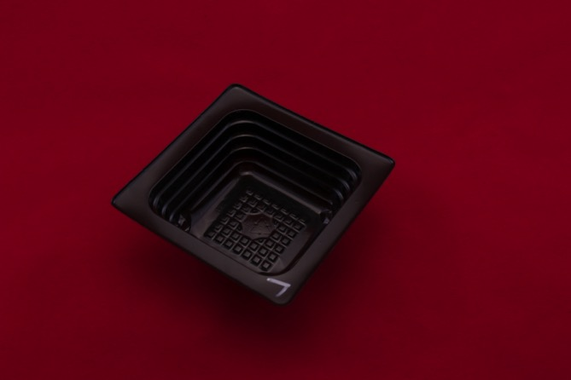
Trash
Notes:
Plastic Container

Slide 22
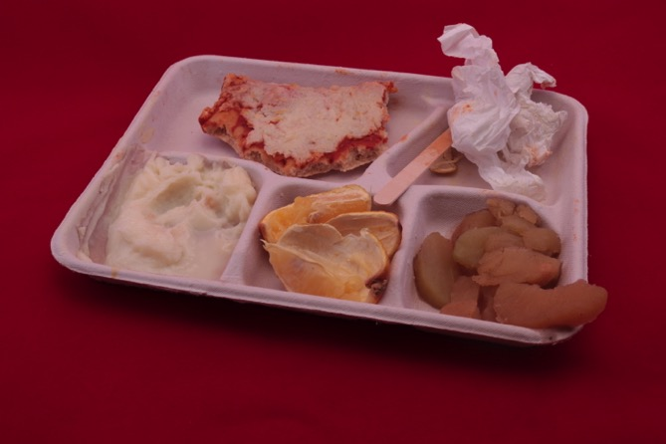
Compost
Notes:
Food Waste, Napkin, Popsicle Stick on Tray

Slide 23
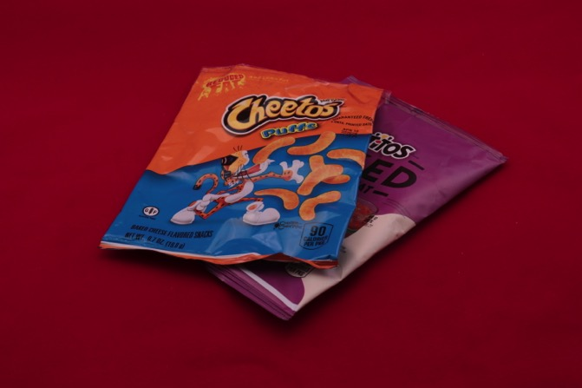
Trash
Notes:
Foil Chips Bags

Slide 24
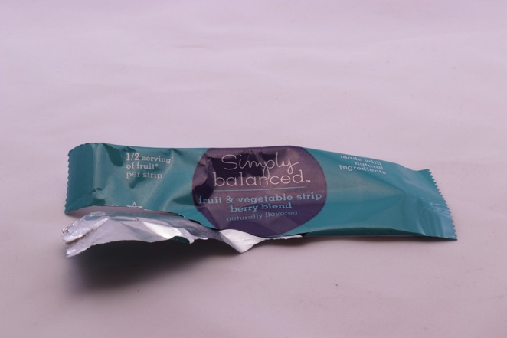
Trash
Notes:
Foil Wrapper

Slide 25
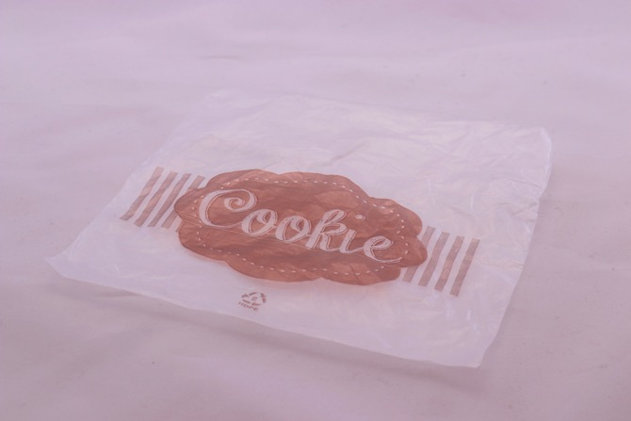
Trash
Notes:
Plastic Cookie Wrapper

Slide 26
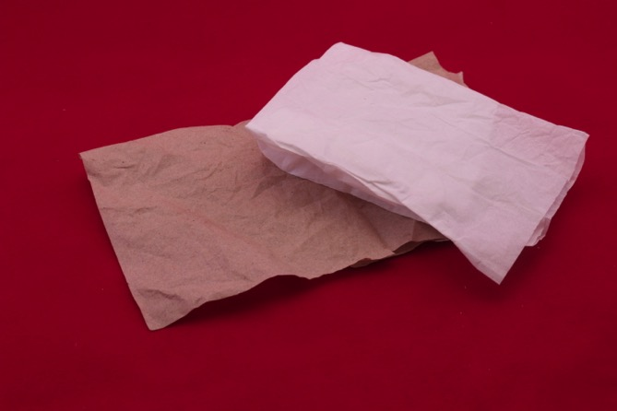
Compost
Notes:
Paper Towels

Slide 27
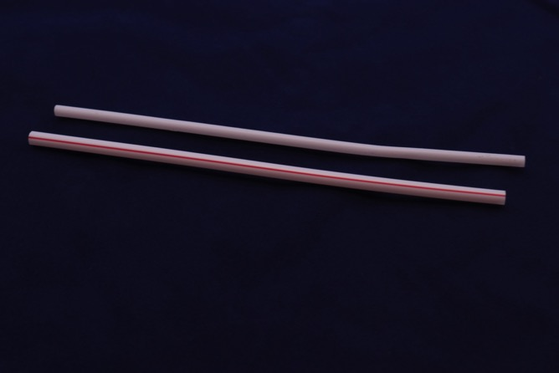
Trash
Notes:
Plastic Straws

